Slide 1

Welcome to STATISTICS 101 Session….
“There are three types of lies -- lies, damn lies, and statistics.”
“Facts speak louder than statistics”
“All Statistical models are wrong…. Some models are useful”
“99 percent of all statistics only tell 49 percent of the story”
“I can prove anything by statistics except the truth..”
“Facts are stubborn, but statistics are more pliable..”
“Statistics are used much like a drunk uses a lamppost: for support, not illumination”

Slide 2
Statistics…Probability….And….!!!
A statistics professor plans to travel to a conference by plane. When he passes the security check, they discover a bomb in his carry-on-baggage. Of course, he is hauled off immediately for interrogation.
"I don't understand it!" the interrogating officer exclaims. "You're an accomplished professional, a caring family man, a pillar of your parish - and now you want to destroy that all by blowing up an airplane!"
"Sorry", the professor interrupts him. "I had never intended to blow up the plane."
"So, for what reason else did you try to bring a bomb on board?!"
"Let me explain. Statistics shows that the probability of a bomb being on an airplane is 1/1000. That's quite high if you think about it - so high that I wouldn't have any peace of mind on a flight."
"And what does this have to do with you bringing a bomb on board of a plane?"
"You see, since the probability of one bomb being on my plane is 1/1000, the chance that there are two bombs is 1/1000000. If I already bring one, the chance of another bomb being around is actually 1/1000000, and I am much safer..."

Slide 3
We are Thankful to….
Courseera.org - Data Analysis and Statistical Inference (Dr. Mine Çetinkaya - Rundel – Duke University)
Basic Econometrics, Fourth Edition – Dr. Damodar Gujarati
Fundamentals of Mathematical Statistics – S.C. Gupta and V.K.Kapoor
Fundamentals of Statistics - Goon A M, Gupta M K, B. Dasgupta
Statistical Methods – N.G.Das
All our Professors and Teachers and Friends and colleagues…
Last But Not Least – the Internet

Slide 4
Course Scope (Covered in session)
Data Basic
Sampling and Sources of bias
Central Tendency
Measure of Spread
Visualizing Numeric Data
Data Transformation
Exploring Categorical Variables
Concept of Probability
Normal Distribution
Binomial and Poison Distribution
Central Limit Theorem
Confidence Interval
Hypothesis Testing
One Sided – Two Sided Tests
Chi-Square Test
Correlation

Slide 5
Data Basics
All Variables
Numerical
Continuous
Discrete
Categorical
Regular Categorical
Ordinal
Notes:
https://www.youtube.com/watch?v=Coe0N2xb8kk (Understanding Types of Data)
https://www.youtube.com/watch?v=LPHYPXBK_ks (How to Remember the differences)
https://www.youtube.com/watch?v=oHGr0M3TIcA (The Basics: Descriptive and Inferential Statistics)

Slide 6
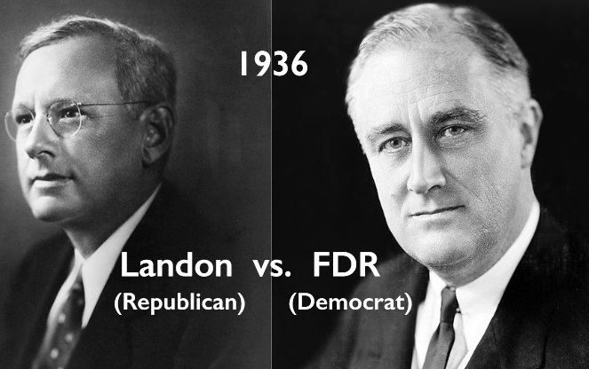

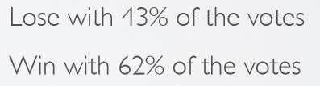
Population, Sample and Sources of Bias
Population : A population includes each element from the set of observations that can be made.
E.g. MNC Employees residing in Bangalore, All Honda cars manufactured in 2014.
Sample : A sample consists only of observations drawn from the population.
E.g. Fidelity Employees from EGL and Manyata, Honda City manufactured in Q2 of 2014.
In statistics & survey methodology, sampling is concerned with the selection of a subset of individuals (sample) from within a statistical population to estimate characteristics of the whole population.
In cases, when the universe (population) is very large, then the sampling method is the only practical method for collecting the data. It is economical, scientific and consumes less time.
Disadvantages of sampling
Chances of introducing sampling bias.
Sampling Error.
Will never be an exact representation of the population.
Some Sources of Sampling Bias
Convenience sample: Individuals who are easily accessible are more likely to be included in the sample
Non-Response: If only a (non-random) fraction of the randomly sampled people respond to a survey such that the sample is no longer representative of the population.
Voluntary Response : Occurs when the sample consists of people who volunteer to respond because they have strong opinions on the issue
Notes:
https://www.youtube.com/watch?v=VtGYaYW-tAk (Population and Sample)
https://www.youtube.com/watch?v=gF-XOHRX7wk (Parameter and Statistics (1/2))
https://www.youtube.com/watch?v=1o6N8Q2rOYA (Parameter and Statistics (2/2))

Slide 7
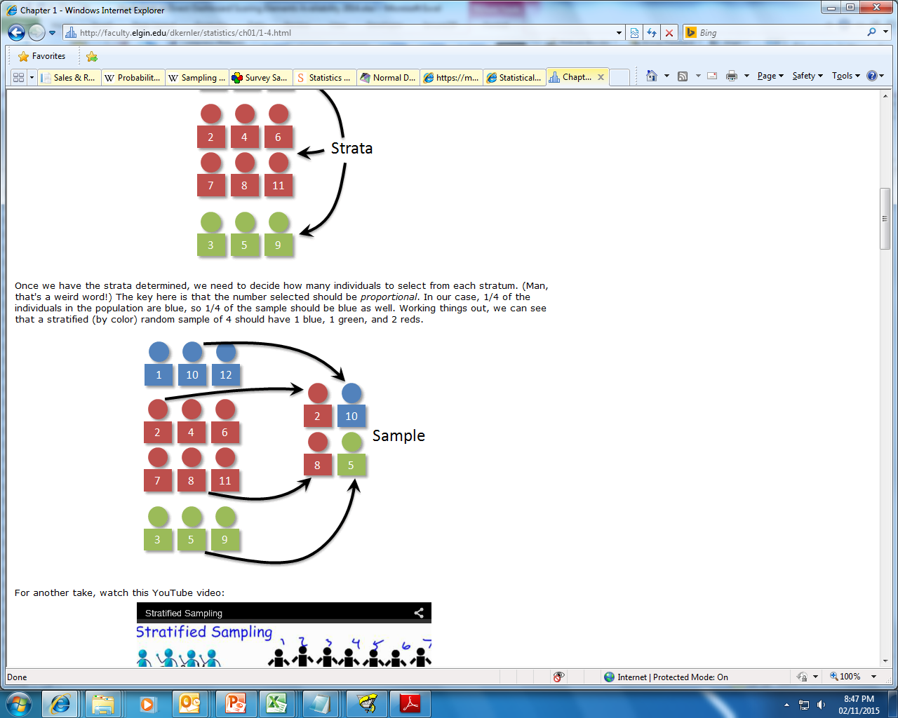
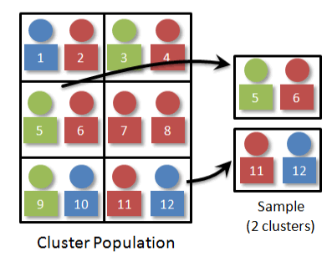
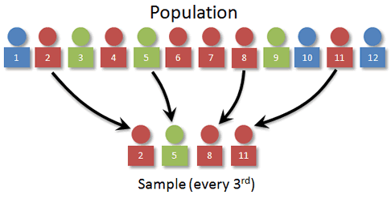
Popular Sampling Methods
Simple random sampling is the simplest form of sampling. Each member of the population has an equal and known chance of being selected.
Systematic sampling is often used instead of random sampling. It is also called an Nth name selection technique. This involves a random start and then proceeds with the selection of every k’th element from then onwards. In this case, k=(population size/sample size).
Stratified sampling is commonly used probability method that is superior to random sampling because it reduces sampling error. A stratum is a subset of the population that share at least one common characteristic. Examples of stratums might be males and females, or managers and non-managers. The researcher first identifies the relevant stratums and their actual representation in the population. Random sampling is then used to select a sufficient number of subjects from each stratum. "Sufficient" refers to a sample size large enough for us to be reasonably confident that the stratum represents the population. Stratified sampling is often used when one or more of the stratums in the population have a low incidence relative to the other stratums.
Cluster sampling is a sampling technique where the entire population is divided into groups, or clusters, and a random sample of these clusters are selected. All observations in the selected clusters are included in the sample.
Notes:
https://www.youtube.com/watch?v=be9e-Q-jC-0 (Sampling)
https://www.youtube.com/watch?v=yx5KZi5QArQ (Simple Random Sampling)

Slide 8
Central Tendency – Measure of Centre
Category | Description | Advantage | Disadvantage | Example
Mean (Arithmetic Mean) | The arithmetic mean of a set of data is found by taking the sum of the data, and then dividing the sum by the total number of values in the set. A mean is commonly referred to as an average. | Simple to Understand/explain Takes every value into account. | Affected by extreme values | Mean of the series 1-10 would be (1+2+…10)/10 = 5.5
Median | The median of a finite list of numbers can be found by arranging all the observations from lowest value to highest value (or highest to lowest) and picking the middle one. | Finds the middle number of a set of data, so outliers have little or no effect | If the gap between some numbers is large, while it is small between other numbers in the data, this can cause the median to be a very inaccurate way to find the middle of a set of values. | Case 1 – Median of the series (1-11) would be - 6 Case-2 – Median of the series (1-10) would be (5+6)/2 =5.5
Mode | The mode is the value that occurs most frequently in a data set | Allows you to see what value happened the most in a set of data. This can help you to figure out things in a different way. It is also quick and easy. | Could be very far from the actual middle of the data. The least reliable way to find the middle or average of the data. | Example 1 –(1,2,3,4,4,5) - Mode 4 Example 2 – (1,2,2,3,3,4) – Mode 2,3 Example 3 – (1,1,2,2,3,3) – No Mode
USAGE: Incase the dataset contains outliers, it is suggested that one uses Median instead of Mean as the average reported could be highly skewed by outliers, but again it depends on how we use this data.
E.g. College placement committee would want to lure students by reporting mean salary received by its students but a student seeking admission should consider median as the average reported could be biased by couple of highly compensated international placements.
Notes:
https://www.youtube.com/watch?v=fqFiXQN_y_k (Measure of Central Tendency)
https://www.youtube.com/watch?v=XVP4seIzW-U (Choosing the Best Measure of Central Tendency)

Slide 9
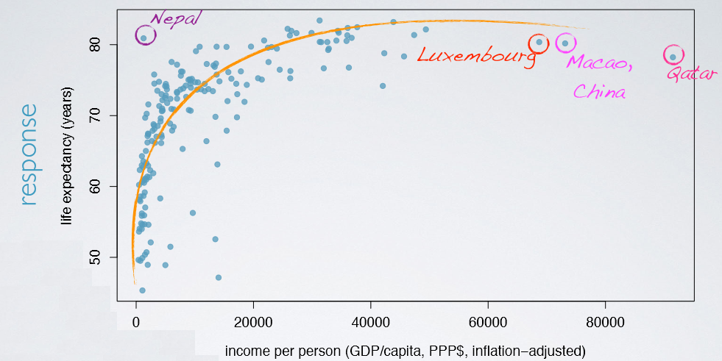

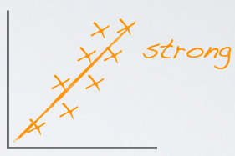
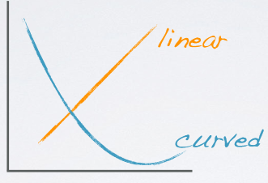
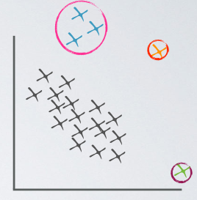
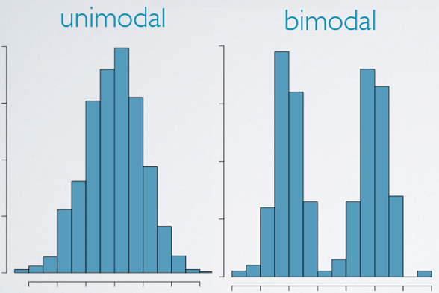
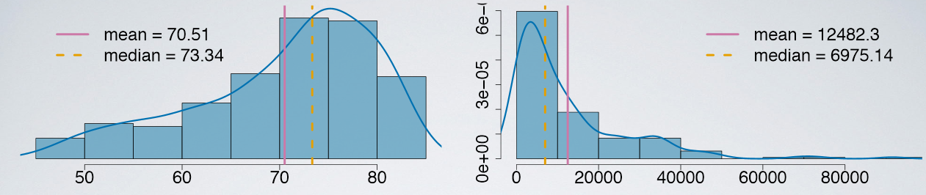
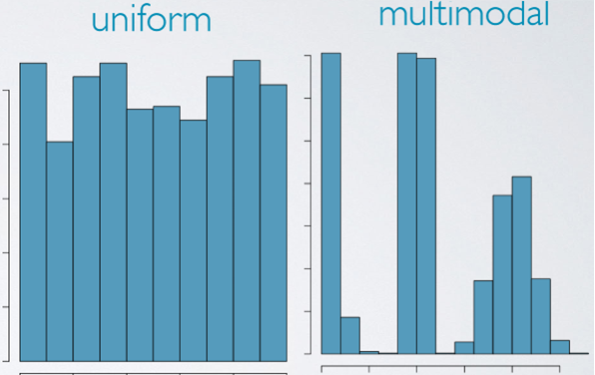
Working on Numerical Data…And Visualizing…!!!

Slide 10
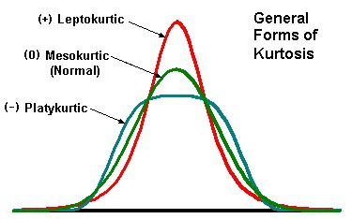
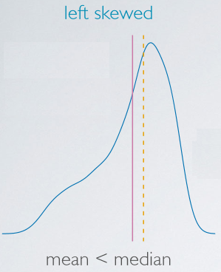
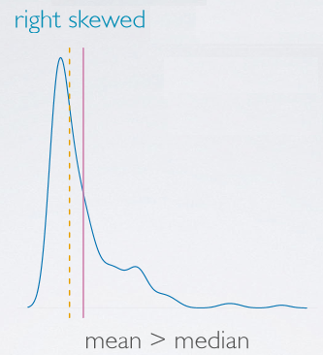
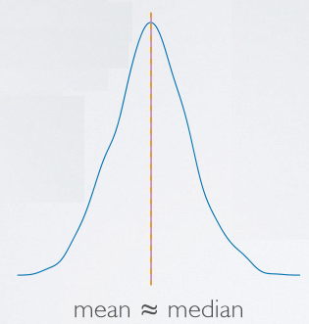
Skewness and Kurtosis!
Skewness: It is the degree of departure from symmetry of a distribution.
•Skewness > 0 - Right skewed distribution - most values are concentrated on left of the mean, with extreme values to the right.
•Skewness < 0 - Left skewed distribution - most values are concentrated on the right of the mean, with extreme values to the left.
•Skewness = 0 - mean = median, the distribution is symmetrical around the mean.
Kurtosis: It is the degree of peakedness of a distribution.
•Kurtosis > 3 - Leptokurtic distribution, sharper than a normal distribution, with values concentrated around the mean and thicker tails. This means high probability for extreme values.
•Kurtosis < 3 - Platykurtic distribution, flatter than a normal distribution with a wider peak. The probability for extreme values is less than for a normal distribution, and the values are wider spread around the mean.
•Kurtosis = 3 - Mesokurtic distribution - normal distribution for example.
Pattern | Distribution
Mean < Median | Left Skewed
Mean > Median | Right Skewed
Mean = Median | Symmetric
Notes:
https://www.youtube.com/watch?v=lBuJmzyiu8Y (Skewness)
https://www.youtube.com/watch?v=Nhlof2T-tV4 (Kurtosis)

Slide 11
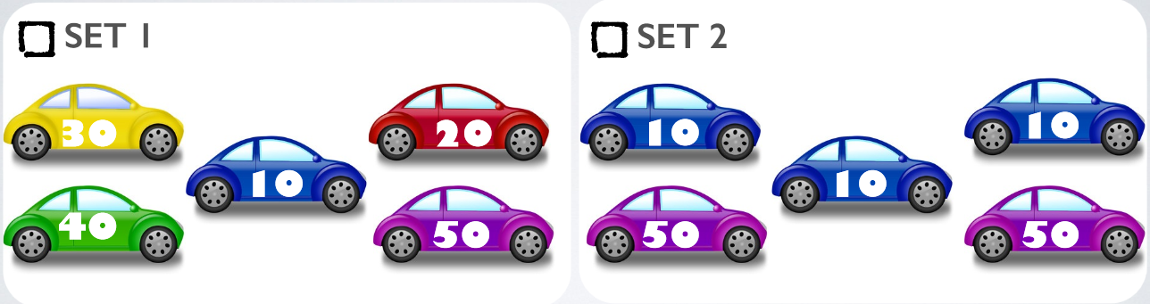
Dispersion – Measure of Spread
Range: The difference between the largest and the smallest value in the dataset. Since the range only takes into account two values from the entire dataset, it may be heavily influenced by outliers in the data.
Interquartile range : Distance between the 25th and 75th percentiles (Q3 - Q1). By definition, this contains 50% of the data points in a dataset.
Mean Deviation: The average of the absolute values of the differences between individual numbers and their mean.
Standard deviation (represented by the symbol σ): shows how much variation or "dispersion" exists from the average (mean, or expected value). A low standard deviation indicates that the data points tend to be very close to the mean, whereas high standard deviation indicates that the data points are spread out over a large range of values. The square of SD is know as Variance.
Coefficient of Variation: It’s a relative measure. The formula is (SD/Mean)*100
Which of the following sets of cars has a more diverse composition of colors?
Which of the following sets of cars has more variable mileage?
Notes:
https://www.youtube.com/watch?v=Snf6Wpn-L4c (Percentiles and Quartiles)
https://www.youtube.com/watch?v=gp_fUdPXpG4 (Measure of Dispersion)
https://www.youtube.com/watch?v=92s7IVS6A34 ( N for Population vs. N-1 for Sample Explained)
https://www.youtube.com/watch?v=9ONRMymR2Eg

Slide 12

Probability Theory
Probability theory is the branch of mathematics concerned with the analysis of random phenomena/process.
Random Process : Random processes (and variables) talk about quantities and signals which are unknown in advance. In a random process we know what outcomes could happen, but we don’t know which particular outcome will happen.
Random Variable, is a variable whose possible values are numerical outcomes of a random phenomenon. There are two types of random variables, discrete and continuous.
Probability: Probability is the measure of the likeliness that an event will occur. Probability is quantified as a number between 0 and 1 (where 0 indicates impossibility and 1 indicates certainty).
Trial: Any particular performance of a random experiment is called a trial.
E.g.: Rolling a die, Running a Direct Mail campaign
Experiment: This is considered to be a larger entity formed by the combination of a number of trials.
E.g.: A game of a 3 coin tosses, Pick a random card from a deck and roll a die.
Event/Outcome: A result that is caused by some previous action. The results or outcomes or observations of an experiment are called events.
E.g.: Appearance of six in the roll of a die, # of responders in a campaign
Notes:
https://www.youtube.com/watch?v=usY1oY0bWQ8 (Introduction to Probability)

Slide 13
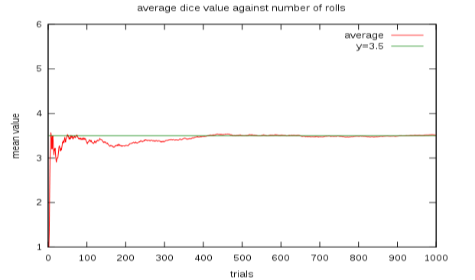
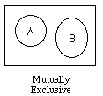
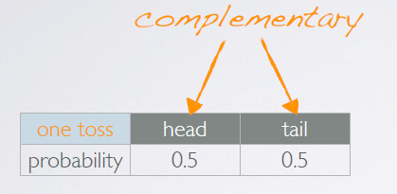
Concepts Related to Probability Theory
Law of Large Numbers:
According to this law, the average of the results obtained from a large number of trials should be close to the expected value, and will tend to become closer as more trials are performed.
E.g.: If a large number of six-sided dice are rolled, the average of their values (sometimes called the sample mean) is likely to be close to 3.5, with the precision increasing as more dice are rolled.
Sample Space: This is a collection of all possible outcomes of a trial.
Mutually Exclusive/Disjoint Events: Events are said to be mutually exclusive or disjoint when
the occurrence of one of the events is not associated with the occurrence of the other(s).
Independent Events: A set of events are independent if knowing the outcome of one provides
no useful information about the outcome of the other.
Complementary Events: Complementary events are two mutually exclusive events
whose probabilities add up to 1.

Slide 14
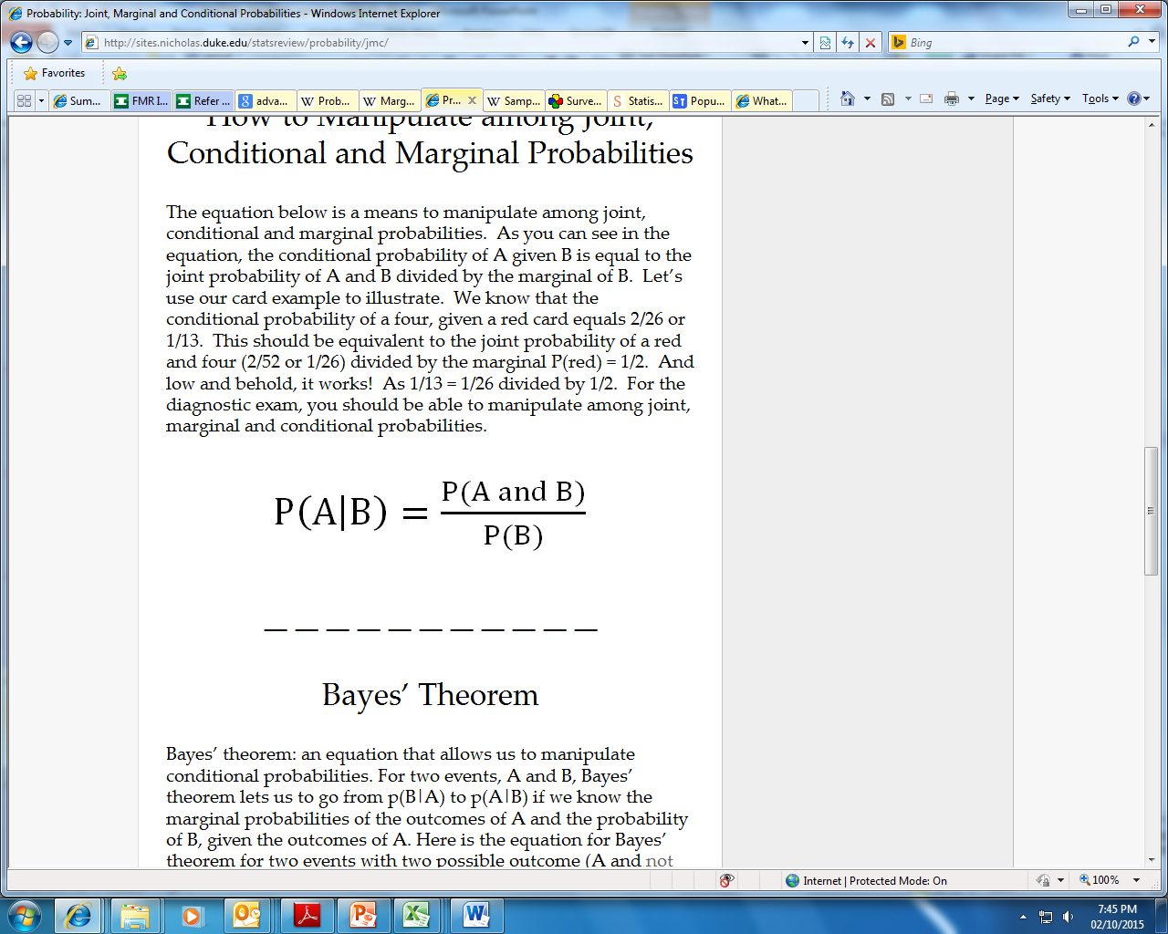
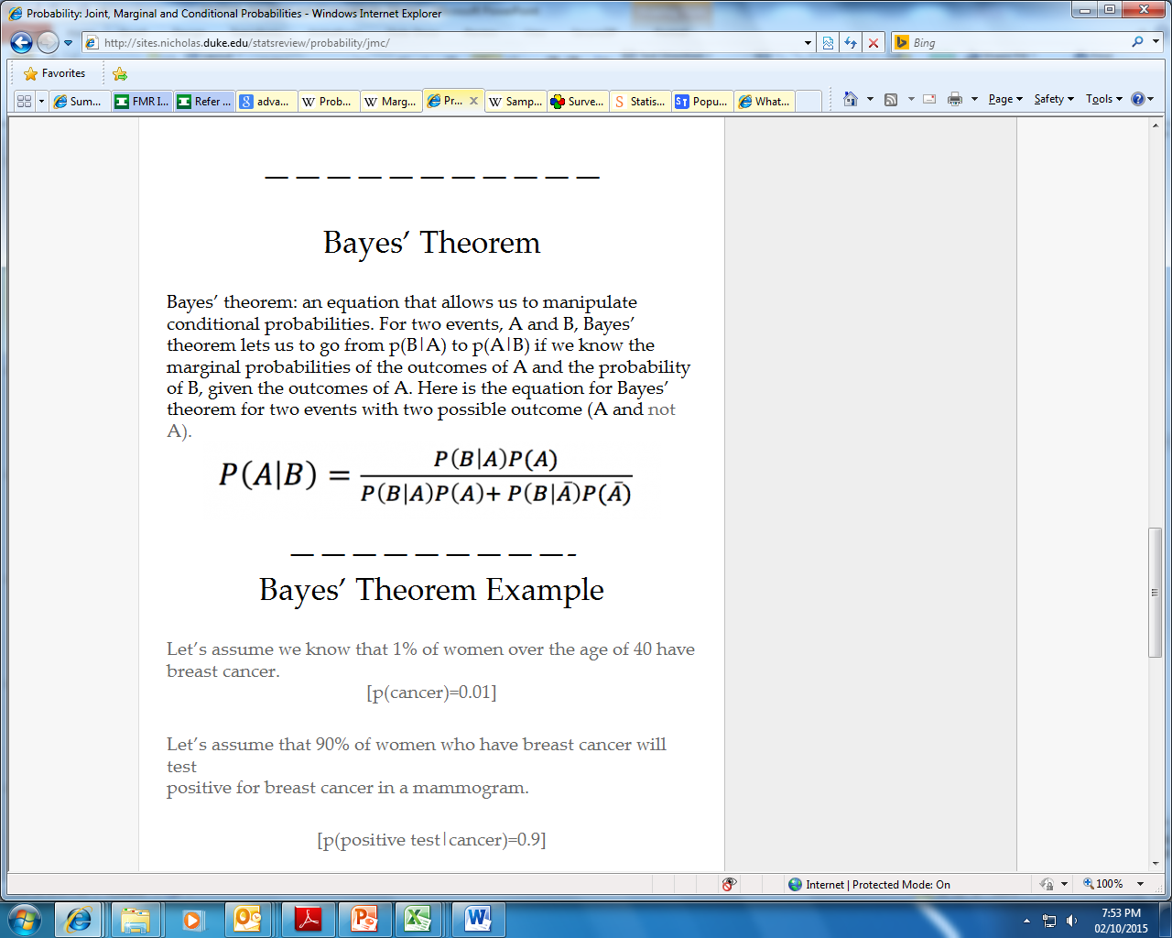
Continued Concepts….Marginal, Joint, Conditional Probabilities
Simple or Marginal probability: The probability of an event occurring (p(A)), which is not conditioned on another event. Example: the probability that a card drawn is red (p(red) = 0.5). Another example: the probability that a card drawn is a 4 = (p(four)=1/13).
Joint probability: p(A and B) The probability of event A and event B occurring. It is the probability of the intersection of two or more events. The probability of the intersection of A and B may be written p(A ∩ B). Example: the probability that a card is a four and red =p(four and red) = 2/52=1/26. (There are two red fours in a deck of 52, the 4 of hearts and the 4 of diamonds).
Conditional probability: p(A|B) is the probability of event A occurring, given that event B occurs. Example: given that you drew a red card, what’s the probability that it’s a four (p(four|red))=2/26=1/13. So out of the 26 red cards (given a red card), there are two fours so 2/26=1/13.
The conditional probability of A given B is equal to the joint probability of A and B divided by the marginal of B.
Bayes’ theorem: An equation that allows us to manipulate conditional probabilities. For two events, A and B, Bayes’ theorem lets us to go from p(B|A) to p(A|B) if we know the marginal probabilities of the outcomes of A and the probability of B, given the outcomes of A.
Notes:
https://www.youtube.com/watch?v=H02B3aMNKzE (Conditional Probability)
https://www.youtube.com/watch?v=Y-V4rfdl3NI (Baye’s Theorem)

Slide 15
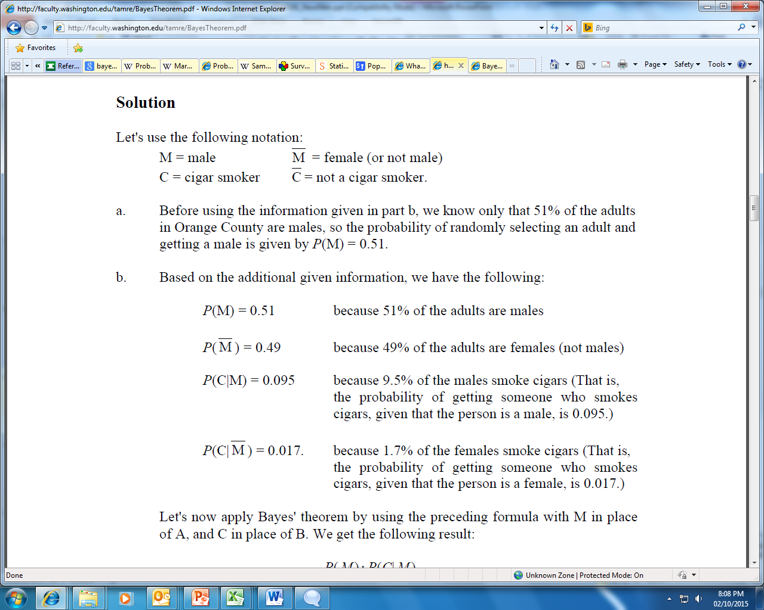

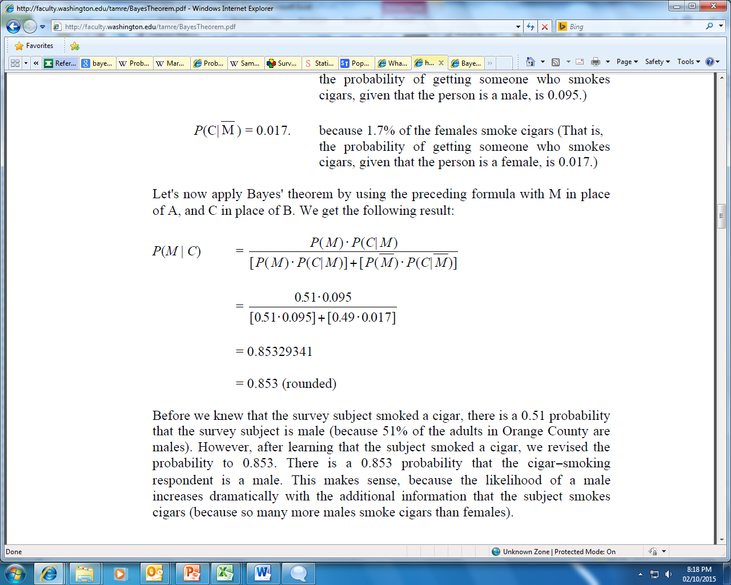
Bayes Theorem: An example…
In Boston, 51% of the adults are males. One adult is randomly selected for a survey involving credit card usage.
a) Find the probability that the selected person is a male.
b) It is later learned that the selected survey subject was smoking a cigar. Also, 9.5% of males smoke cigars, whereas 1.7% of females smoke cigars. Use this additional information to find the probability that the selected subject is a male.
Solution:
Notations:
a) Before using the information given in part b, we know only that 51% of the adults in Boston are males, so the probability of randomly selecting an adult and getting a male is given by P(M) = 0.51.
b) Using additional information provided, we get:
Using Bayes Theorem we have:
Before we knew that the survey subject smoked a cigar, there is a 0.51 probability that the survey subject is male. However, after learning that the subject smoked a cigar, we revised the probability to 0.853. There is a 0.853 probability that the cigar-smoking respondent is a male. This makes sense, because the likelihood of a male increases dramatically with the additional information that the subject smokes cigars (because many more males smoke cigars than females).

Slide 16
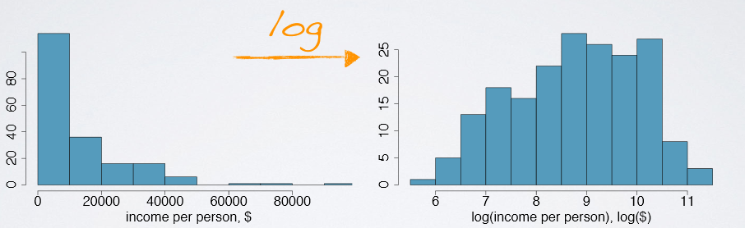
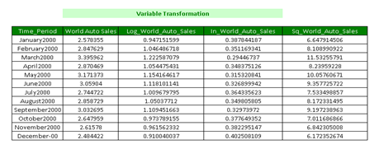
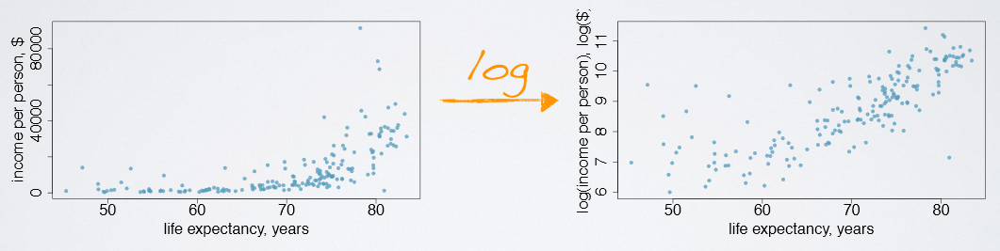
Variable Transformation
A transformation is a rescaling of the data using a function
When data are very strongly skewed, we sometimes transform them so they are easier to model
Transformations can also be applied to one or both variables in a scatterplot to make the relationship between the variables more linear, and hence easier to model with simple methods
We generally use 6 types of transformations – log, inverse, cube, cube-root, square, square-root to generate better explanatory power
Log, square-root & inverse transform positively skewed data into a more symmetric form.

Slide 17
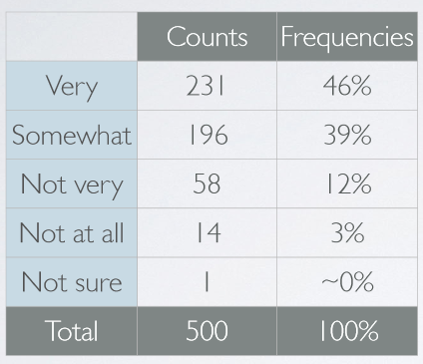
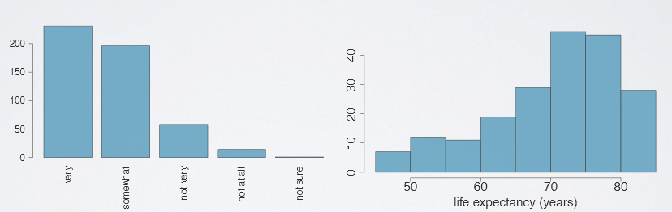
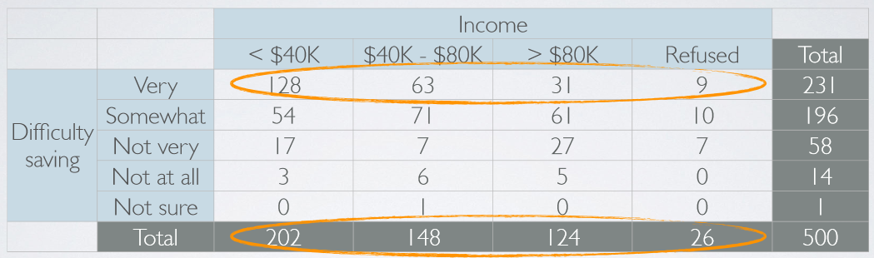
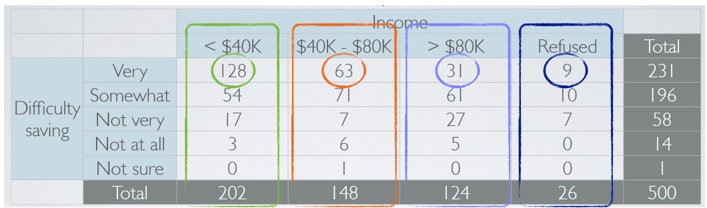
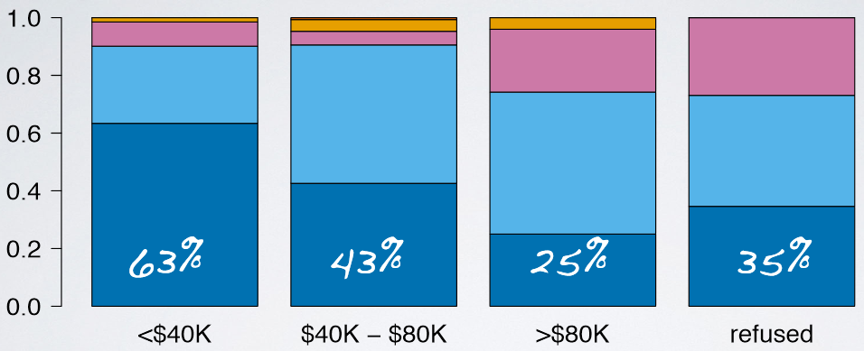
Exploring Categorical Variables
A 2014 poll in the US asked respondents how difficult they think it is to save money
Useful for visualizing conditional frequency distributions
In order to explore the relationship between the variables, we need to compare relative frequencies

Slide 18
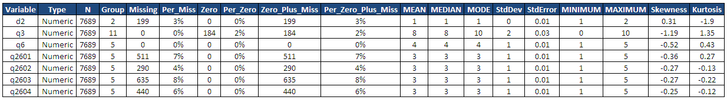
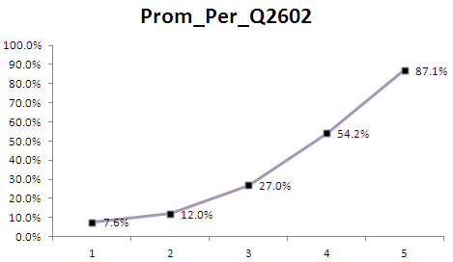
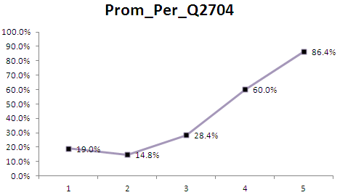
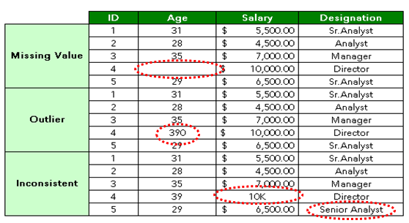
Data Treatment and Exploratory Data Analysis….
Univariate Analysis
Bivariate Analysis
Other Typical Methods ---
Frequency Check
Cross Tabulation b/w Variable
Interaction Effect
Data Treatment
Notes:
https://www.youtube.com/watch?v=Ukkcer70r5A (Outlier Treatment – Part 1)
https://www.youtube.com/watch?v=FatA5COFIPU (Part 2)

Slide 19
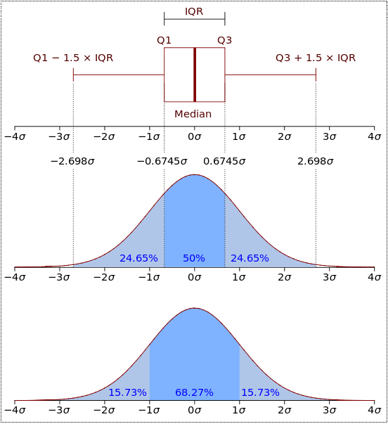
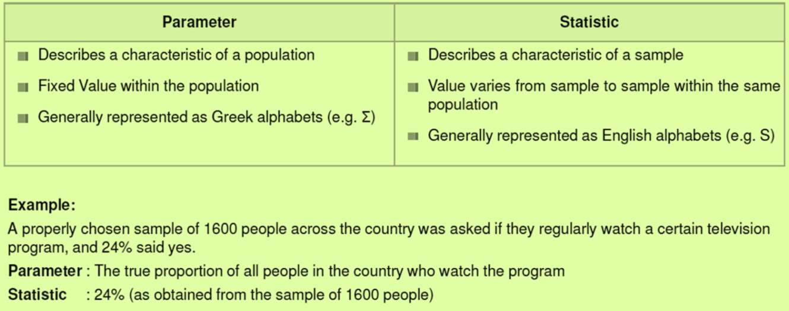
Distribution…parameter…statistics !!
A Probability Distribution assigns a probability to each measurable subset of the possible outcomes of a random experiment, survey, or procedure of statistical inference.
In probability theory, a Probability Density Function (PDF), or density of a continuous random variable, is a function that describes the relative likelihood for this random variable to take on a given value. The probability of the random variable falling within a particular range of values is given by the integral of this variable’s density over that range. The probability density function is nonnegative everywhere, and its integral over the entire space is equal to one.
Continuous distributions describe an infinite number of possible data values.
Example: Normal Distribution, Chi-Square Distribution, Student’s T Distribution
Discrete distributions describe a finite number of possible values.
Example: Binomial Distribution, Poisson Distribution
Parameters are numbers that summarize data for an entire population.
Statistics are numbers that summarize data from a sample, i.e. some subset of the entire population.
Parameters are usually unknown and estimated using statistics from sample.
Notes:
https://www.youtube.com/watch?v=YUfUp5DDhWg (Probability Distribution)

Slide 20
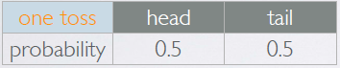
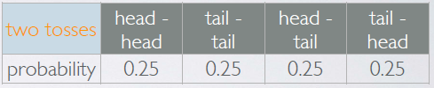
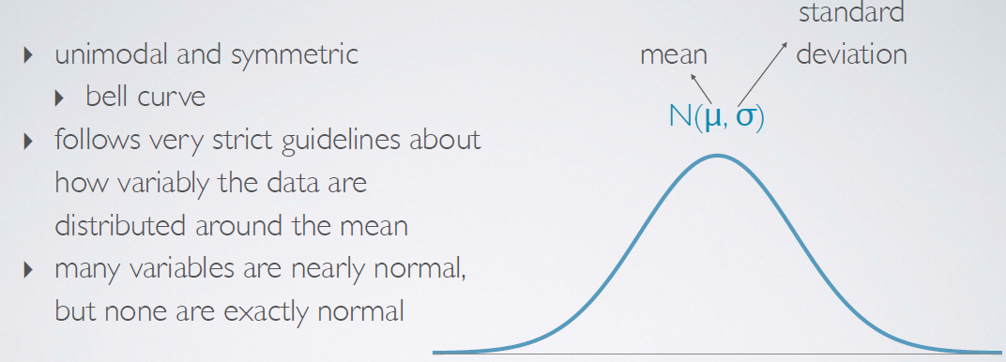
Normal Distribution….
Probability Distribution : This lists all possible outcomes in the sample space and the probabilities with which they occur.
Rules applicable to a distribution:
(a) The events listed must be disjoint (b) Each probability must be between 0 and 1 (c) The probabilities must total 1
Normal Distribution: A normal distribution is an arrangement of a data set in which most values cluster in the middle of the range and the rest taper off symmetrically toward either extreme.
Notes:
https://www.youtube.com/watch?v=mai23vW8uFM (Normal Distribution and Z-Score)

Slide 21
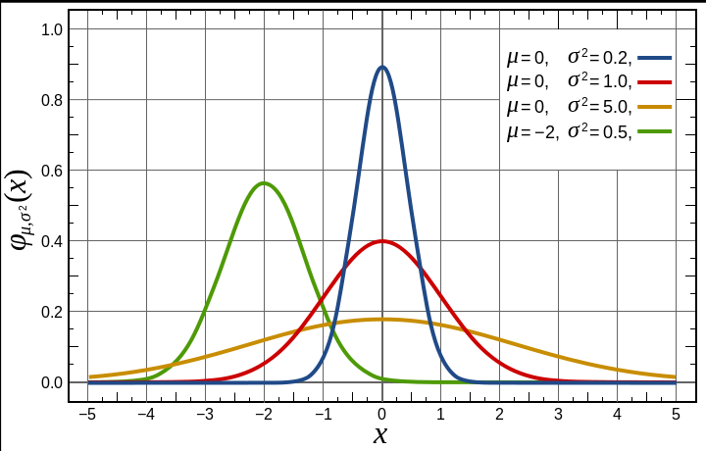
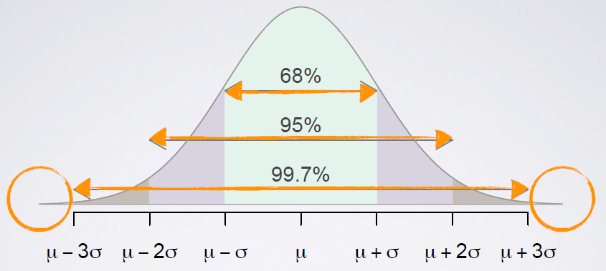

Normal Distribution – Area…Shape…Size…
Different shapes and sizes of Normal distributions
Area Under the Normal Distribution Curve

Slide 22
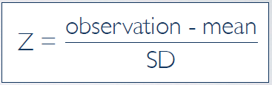
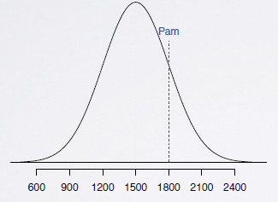
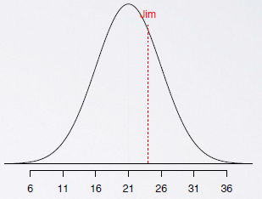
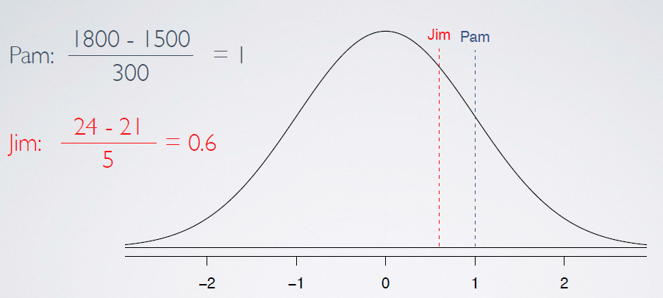
Standardized Z-Score
Case: A college admissions officer wants to determine which of the two applicants scored better on their standardized test with respect to the other test takers: Pam, who earned a 1800 on her SAT, or Jim, who scored a 24 on his ACT?
SAT scores ~ N(mean=1500, SD=300) ; ACT ~ N(mean=21, SD=5)
Standardizing with Z-scores : Standardized (Z) score of an observation is the number of standard deviations it falls above or below the mean
Key Points :
Z-score of mean =0
Unusual observation :|Z| > 2
Defined for distributions of any shape
Comparing the SAT and ACT scores using standardized
Z-score indicates that indeed Pam has scored better
than Jim. This is illustrated by the fact that Pam’s scores are further away (higher S.D. of 1) from the mean than Jim’s score, thus positioned at a score point that is more than Jim’s.

Slide 23
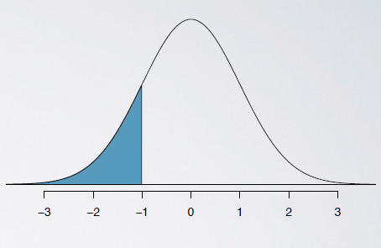
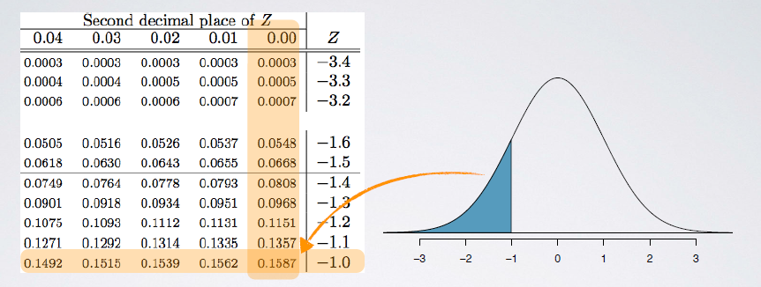
Percentiles
Percentiles:
When the distribution is normal, Z scores can be used to calculate percentiles
Percentile is the percentage of observations that fall below a given data point
Graphically, percentile is the area below the probability distribution curve to the left of that observation
Computing Percentiles:

Slide 24
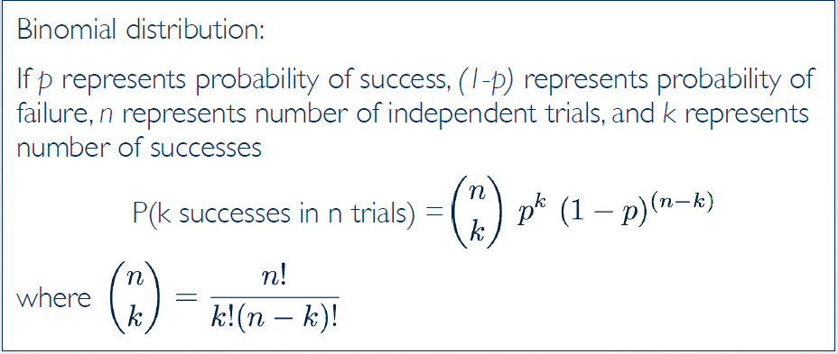

Binomial Distribution
Binomial Distribution: This probability distribution describes the probability of having exactly ‘k’ successes in ‘n’ independent Bernoulli trials with probability of success ‘p’
Used to model the number of successes (ie. Occurrence of an event ) in a finite number of trials (n trials)
Each trial results in one of two possible outcomes (success or failure)
Each trial has the same probability of success , p
Independent trials
Two parameters (n, p)
Notes:
https://www.youtube.com/watch?v=qIzC1-9PwQo (Binomial Distribution)

Slide 25


Poisson Distribution
Poisson Distribution: A probability distribution that arises when counting the number of occurrences of a rare event in a long series of trials.
Where --- m : average rate of value
x : Poisson random variable.
e : Base of logarithm(e=2.718)
Used to model the rates of occurrence of an event , that is the number of occurrences in a unit of measure
Events can happen at any point along a continuum
At any particular point, the probability of an event is small
The average number of events is constant over a unit of measure
Independent events
One parameter (m : the average number of events in a unit of measure)
Notes:
https://www.youtube.com/watch?v=jmqZG6roVqU (Poisson Distribution)

Slide 26


Normal approximation of Binomial and Poisson Distributions
Normal Approximation to Binomial Distribution
With increasing number of trials (‘n’) and probability of success(‘p)’ becoming smaller the skewed Binomial distribution tends to be approximated by a normal distribution. The Success - Failure rule is imperative for the binomial distribution to follow the normal distribution, given as
n> 40
n*p >=10
and n*(1-p) >=10
Normal Approximation to Poisson Distribution
With increasing value of mean(‘m’) the right skewed Poisson distribution tends to be approximated by a normal distribution. The rule for the Poisson to follow a Normal distribution is
m>10
Notes:
https://www.youtube.com/watch?v=k9nRcadQYsU (The Normal Approximation of the Binomial Distribution)

Slide 27
Central Limit Theorem
Simply put, Central Limit Theorem states that the distribution of sample statistics of a large number of independent, identically distributed variables will be approximately normal, regardless of the underlying distribution.
The mean of the sample means will be the mean of the population
The variance of the sample means will be the variance of the population divided by the sample size.
The standard deviation of the sample means (known as the standard error of the mean) will be smaller than the population mean and will be equal to the standard deviation of the population divided by the square root of the sample size.
If the population has a normal distribution, then the sample means will have a normal distribution.
If the population is not normally distributed, but the sample size is sufficiently large, then the sample means will have an approximately normal distribution.
Assumptions:
Independence: Sampled observations must be independent.
Large sample size in case of non normal distribution
Why is the Central Limit Theorem Important?
If we know the population mean and standard deviation, we know the following will be true:
The distribution of means across repeated samples will be normal with a mean equal to the population mean and a standard deviation equal to the population standard deviation divided by the square root of n. Since we know exactly what the distribution of means will look like for a given population, we can take the mean from a single sample and compare it to the sampling distribution to assess the likelihood that our sample comes from the same population.
Notes:
https://www.youtube.com/watch?v=Pujol1yC1_A (Central Limit Theorem)

Slide 28



Confidence Interval
Confidence Interval : A plausible range of values for the population parameter is called a confidence interval
If we report a point estimate , we probably would not hit the exact population parameter.
If we report a range of plausible values we have a good shot at capturing the parameter.
Notes:
https://www.youtube.com/watch?v=27iSnzss2wM (Confidence Interval Introduction)

Slide 29



Confidence Interval – Contd..

Slide 30

Confidence Interval – Contd..

Slide 31
Hypothesis Testing
A statistical hypothesis is an assumption about a population parameter. This assumption may or may not be true. Hypothesis testing refers to the formal procedures used by statisticians to accept or reject statistical hypotheses.
The best way to determine whether a statistical hypothesis is true would be to examine the entire population. Since that is often impractical, researchers typically examine a random sample from the population. If sample data are not consistent with the statistical hypothesis, the hypothesis is rejected.
Null hypothesis: The null hypothesis, denoted by H0, is usually the hypothesis that sample observations result purely from chance.
Alternative hypothesis: The alternative hypothesis, denoted by H1 or Ha, is the hypothesis that sample observations are influenced by some non-random cause.
Decision Rules - The analysis plan includes decision rules for rejecting the null hypothesis. In practice, statisticians describe these decision rules in two ways - with reference to a P-value or with reference to a region of acceptance.
P-value. The strength of evidence in support of a null hypothesis is measured by the P-value. Suppose the test statistic is equal to S. The P-value is the probability of observing a test statistic as extreme as S, assuming the null hypothesis is true. If the P-value is less than the significance level, we reject the null hypothesis.
Region of acceptance. The region of acceptance is a range of values. If the test statistic falls within the region of acceptance, the null hypothesis is not rejected. The region of acceptance is defined so that the chance of making a Type I error is equal to the significance level.
The set of values outside the region of acceptance is called the region of rejection. If the test statistic falls within the region of rejection, the null hypothesis is rejected. In such cases, we say that the hypothesis has been rejected at the α level of significance
Notes:
https://www.youtube.com/watch?v=tTeMYuS87oU (Hypothesis Testing)

Slide 32


Hypothesis Testing - Contd…
Null Hypothesis - Often either a skeptical or a claim to be tested
Alternative Hypothesis - Represents an alternative claim under consideration and is often represented by a range of possible parameter values
The skeptic will not abandon the null hypothesis unless the evidence in favor of the alternative hypothesis is so strong that the null hypothesis is rejected in favor of the alternative hypothesis.
Confidence Interval leading to Hypothesis testing
Earlier we calculated a 95% confidence interval for the average number of exclusive relationships college students have been in to be (2.7, 3.7). Based on this confidence interval, do these data support the hypothesis that college students on average have been in more than 3 exclusive relationships.

Slide 33

Hypothesis Testing – One Sided Test
Decision based on p-value
We used the test statistic to calculate the P-Value, the probability of observing data at least as favorable to an alternative hypothesis as our current dataset, if the null hypothesis was true
If the P-Value is low (lower than the significance level alpha which is typically 5%), we say that it would be unlikely to observe the data if the Null Hypothesis were true and hence Reject Ho.
If the P-Value is high, we say that it would be likely to observe the data even if the Null Hypothesis were true and hence Do Not Reject Ho.
Interpreting the p-value
If in fact college students have been in 3exclusive relationship on average, there is a 21% chance that a random sample of 50 college student would yield a sample mean of 3.2 or higher. This is a pretty high probability so we think that a sample mean of 3.2 or more exclusive relationship will happen simply by chance
Making a decision
Since the P-Value is high we fail to reject Ho.
The do not data provide convincing evidence that college students have been in more that 3 relationships on average
The difference between the null value of the 3 relationship and the observed sample mean of 3.2 relationship is due to chance or sampling variability.

Slide 34

Hypothesis Testing – Two Sided Test
Two-sided test
Often instead of looking for a divergence from the null in a specific direction, we might be interested in divergence in any direction
We call such hypothesis test Two-Sided or Two-Tailed.
The definition of the P-Value is the same regardless of doing a one or two-sided test, however the calculation is slightly different since we need to consider “at least as extreme as the observed outcome” in both direction

Slide 35

Chi-Square Test

Slide 36

Chi-Square Test

Slide 37

Chi-Square Test

Slide 38

Chi-Square Test

Slide 39

Chi-Square Test

Slide 40

Chi-Square Test

Slide 41






Correlation Concept…
Correlation describes the strength of the Linear Association between two Variables. The Correlation Co-efficient is denoted by R which is always in between -1 (perfect linear negative relationship) and 1 (perfect linear positive relationship)
Absolute value measures strength
Sign indicates Direction
Not Affected by Unit Change
Corr.(Y and X) = Corr.(X and Y)
Outlier Sensitive

Slide 42






Scatter Plots…Guess the Correlation Coefficient…!!!
Notes:
https://www.youtube.com/watch?v=Ypgo4qUBt5o (What is Correlation ?)

Slide 43
Thank You!!

